Slide 1

Customer Retention Project
Exploratory Data Analysis

Slide 2
Introduction
The data, Customer Retention, contains 71 questions asked to 269 clients.
Data collection and data mining are of great relevance and online retailers prove it by improvising and innovating based on feedback of customers.
For example, inventing artificial intelligence bots to display similar products to the ones in the cart, etcetera.
Due to centricity of data mining and innovation, customers experiences are becoming delightful and customer retention is becoming easier.

Slide 3
Problem Statement
How can Data Science help in customer retention?
What kind of predictions can data scientists make with thiis data and can this explain if the customers will stay with the company for a long time? In other terms, what characteristics have more influence in prediction?

Slide 4
Understanding The Data (Part 1)
The data, Customer Retention, contains 71 questions asked to 269 clients.
Data collection and data mining are of great relevance and online retailers prove it by improvising and innovating based on feedback of customers.
For example, inventing artificial intelligence bots to display similar products to the ones in the cart, etcetera.
Due to centricity of data mining and innovation, customers experiences are becoming delightful and customer retention is becoming easier.

Slide 5
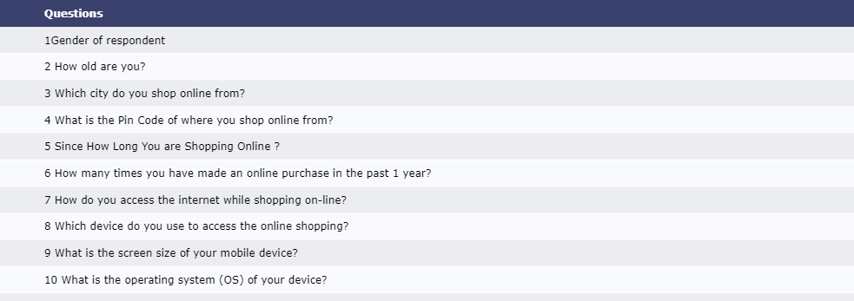
Importing Data: Process of loading or reading data into python.
Some of the questions are mentioned above. (These are column names)

Slide 6
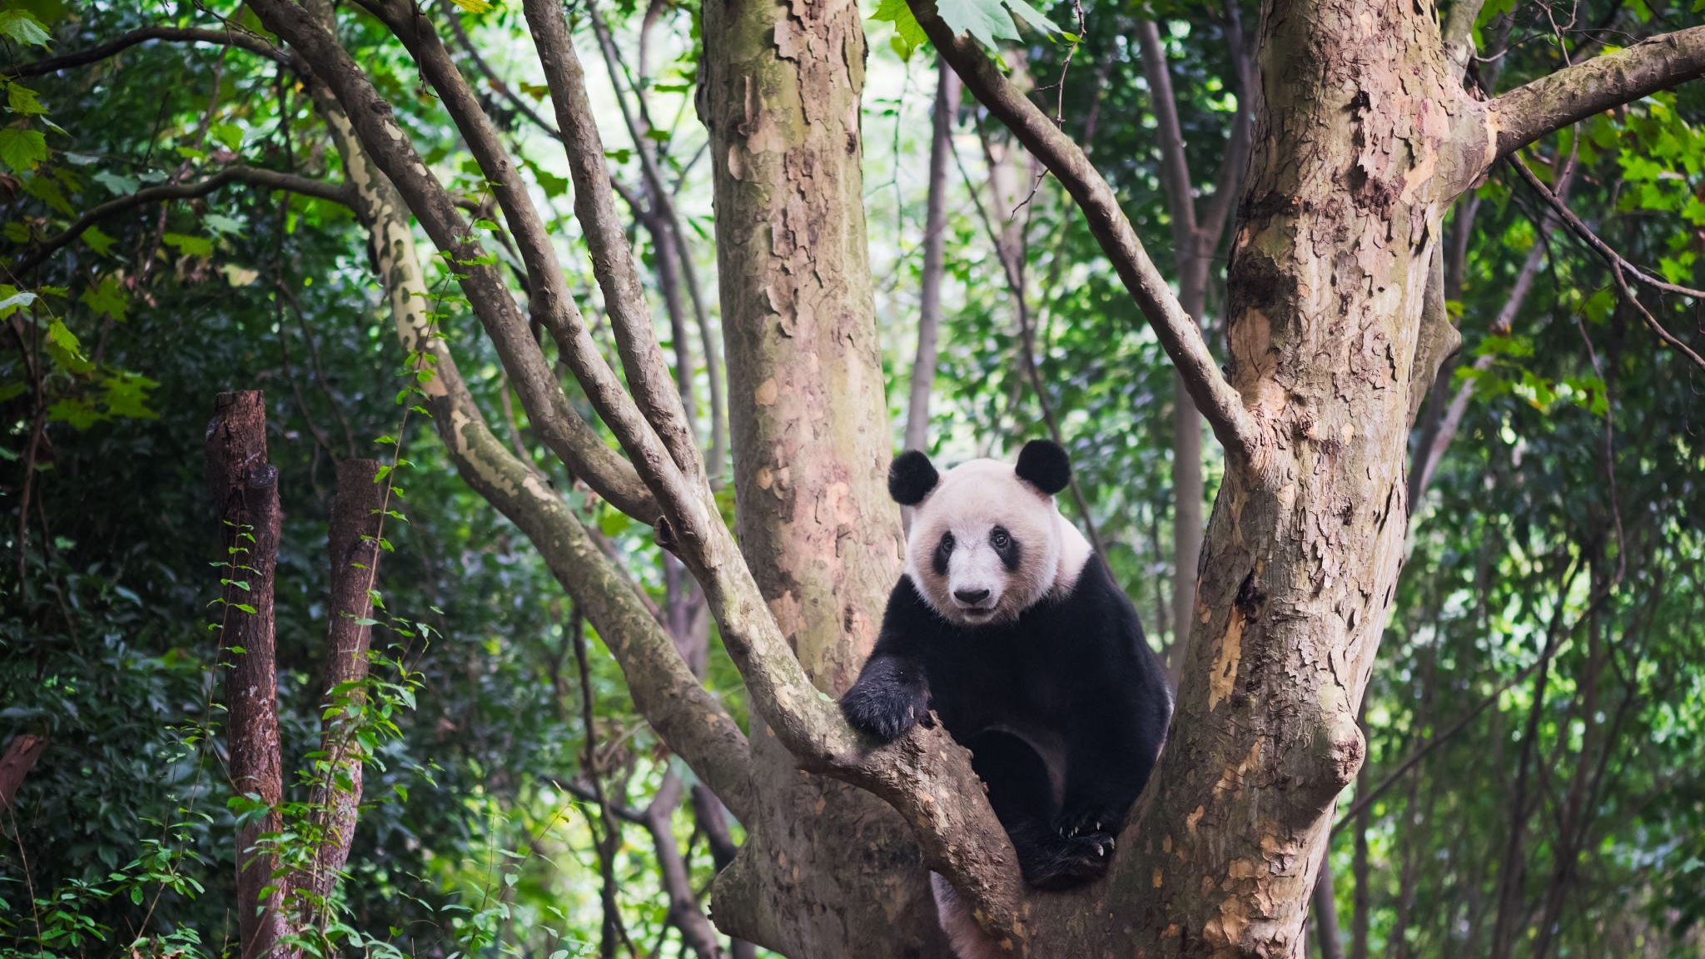
Technical Process
Imported data from pandas library, after converting it in raw format. It is a scientific computing library.
Hard Code=pandas.read_excel(customer_retention.xlsx, sheet_name=1)
Format=xlsx

Slide 7
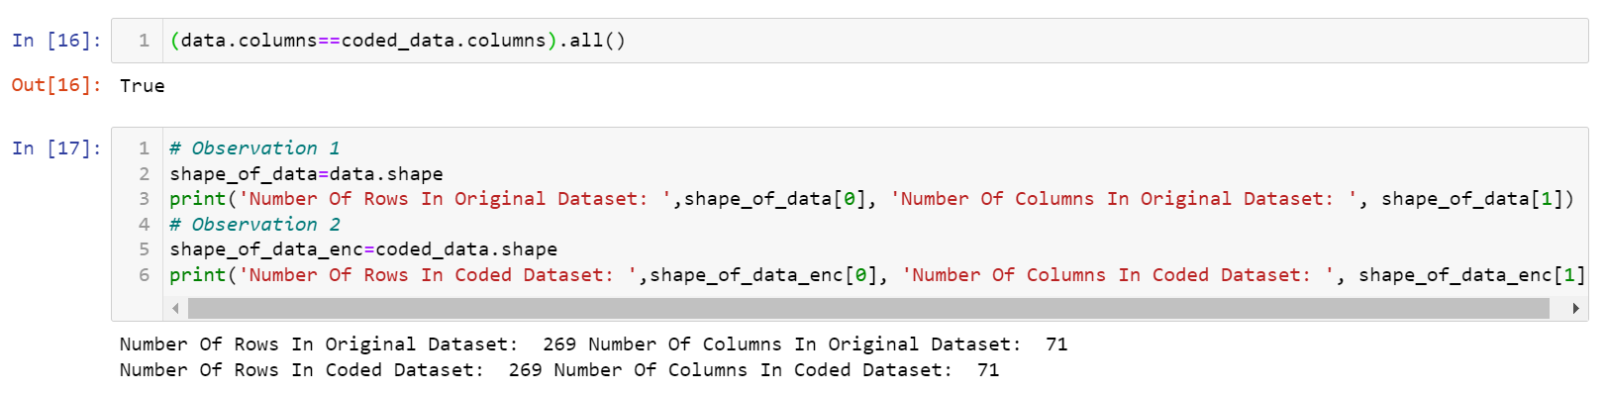
Getting Started With Data Analysis
Check 1 and Check2 to get started with this data

Slide 8
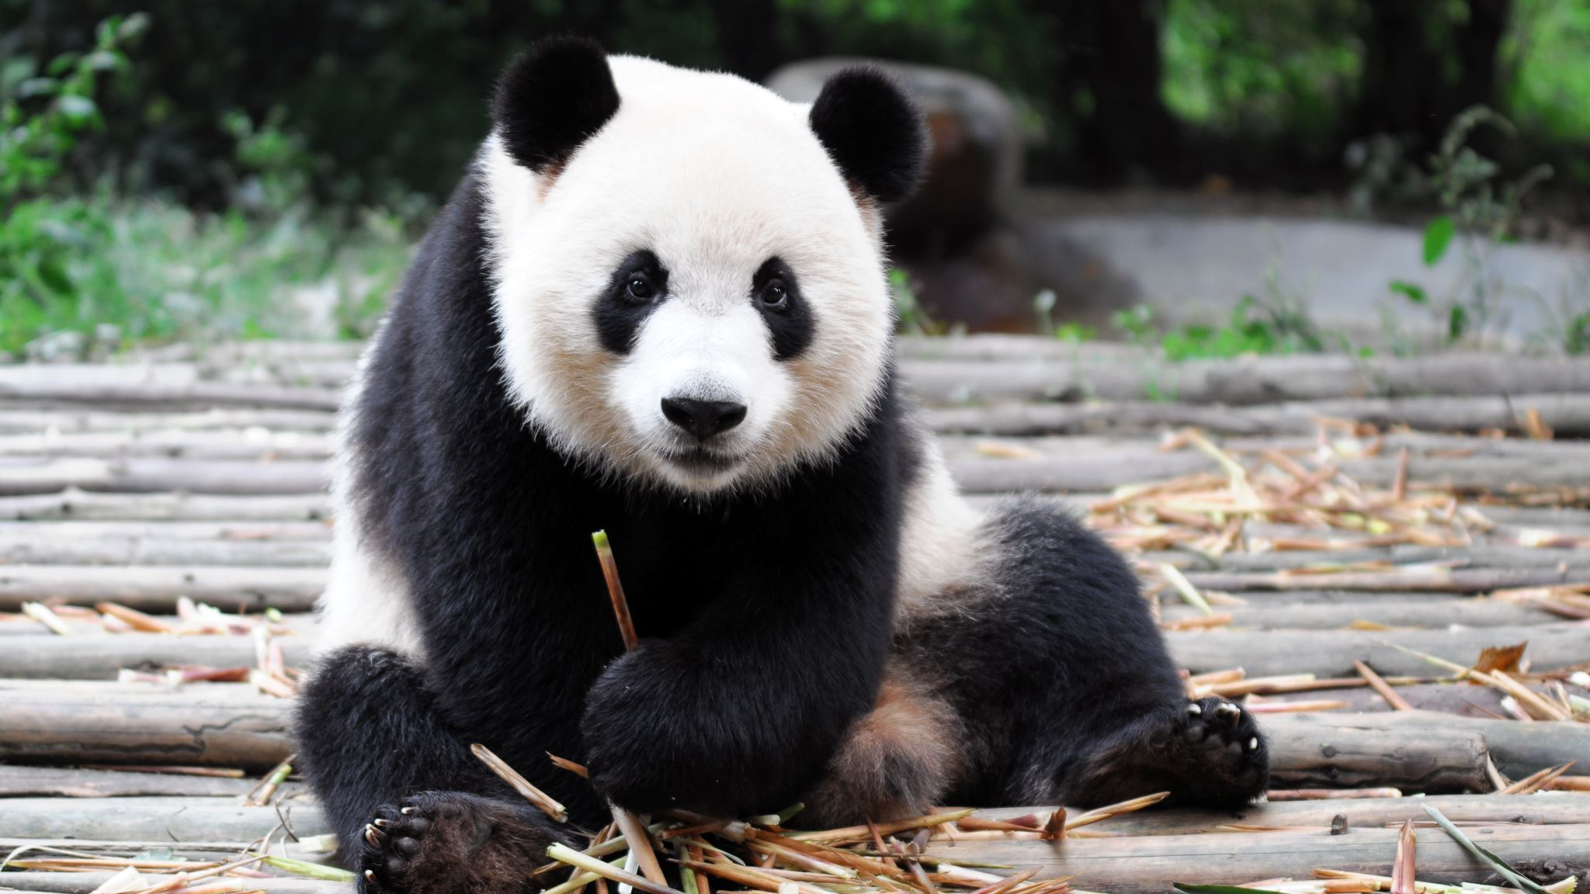
Getting Started With Data Analysis Part 2
<class 'pandas.core.frame.DataFrame'> RangeIndex: 269 entries, 0 to 268 Data columns (total 71 columns).
dtypes: int64(46), object(25) memory usage: 149.3+ KB
Count Of Null Values:0

Slide 9
Data Pre-Processing
Data Pre-Processing is the process of converting or mapping data from initial raw format into another format, in order to prepare data for further analysis.
It involves following steps:
Identify and handle missing data
Data Formatting
Data Normalization (centering/scaling)
Data Binning
Turning categorical Values To Numeric Vales

Slide 10

Data Pre-Processing (contd...)
In the present case, we require to apply 3 steps:
As discussed in preliminary analysis, there are no missing values and hence we do not need to impute.
Also, bining will be performed during visulization so we do not require it as a separate procedure.
Step 1: Data Formatting
Step 2: Turning categorical values to numeric values.
Step 3: Data Normalization (Scaling/Centering)

Slide 11
Steps: 1 And 2
Data are usually collected from different places and stored in different formats.
Bringing data into common standard of expression allows users to make meaningful comparisons.
Non formatted data is:
Confusing
Hard to aggregate
Hard to compare
For example, in column city, New York is stored as NY and ny
Formatted data is:
More clear
Easy to aggregate
Easy to compare
For example, overwriting NY and ny as NewYork.

Slide 12
Steps1 and 2 (contd...)
It also means to convert units of columns to preferred units, example, mpg to l/100km.
Third important step is renaming columns.
Fourth step is to check and convert data types.
Fifth step involves turning categorical values into numeric variables.
Because most statistical models cannot take in the objects/strings as input.

Slide 13
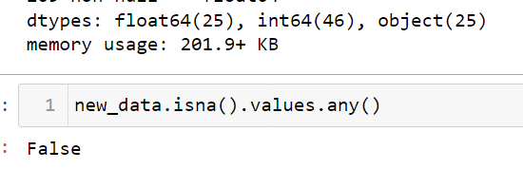
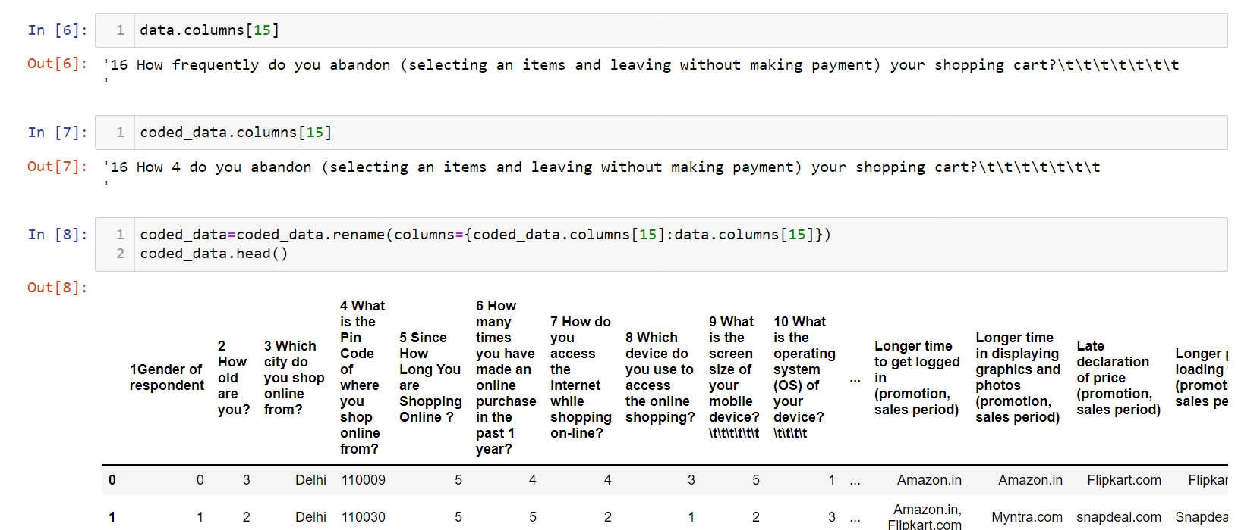
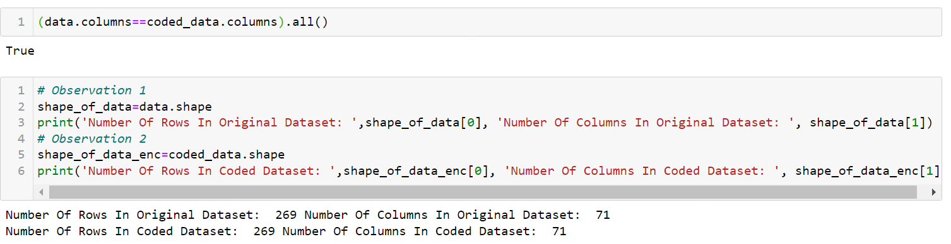
Practical Application Of Steps 1 And 2

Slide 14
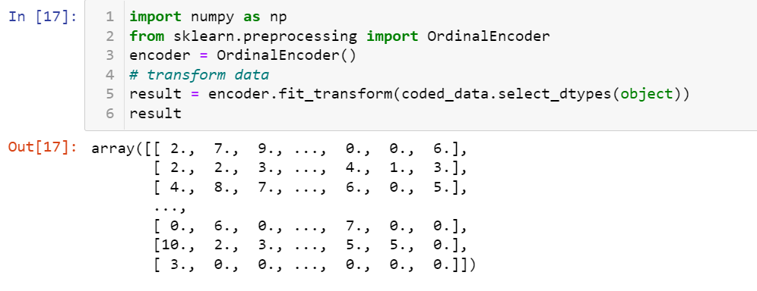
Practical Application Of Steps 1 And 2 (contd....)

Slide 15

Step 3
Data Normalization helps to bring entire dataset within a consistent range, hence, helping in removing bias and making more meaningful analysis.
In the present case, I have applied Standard Scaling, thereby, making the values hover around 0 in the range +/-3.
Main characteristics:
Mean=0
Standard Deviation=consistent
Formula
Xnew = (Xold-Mean)/standard deviation.

Slide 16
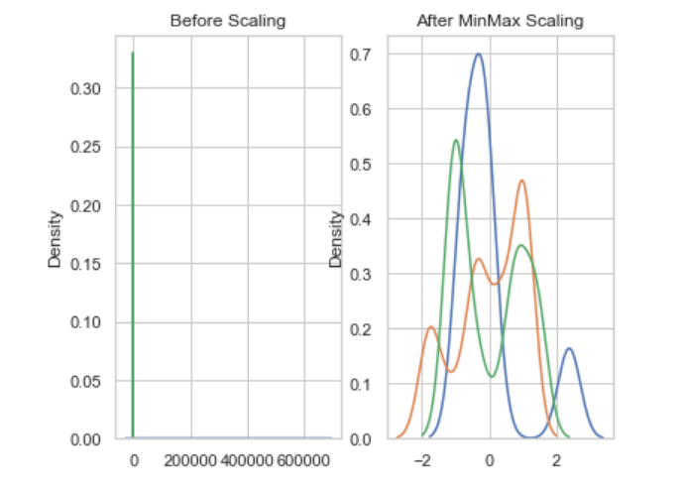
Practical Application Of Step 3: Scaler=Standard Scaler

Slide 17

Exploratory Data Analysis
Preliminary steps in data analysis to:
Main characteristics of data
Gain better understanding of dataset
Uncover relationship between variables
Extract Important Variables
This can be done by visualizing:
Descriptive statistics
Group By
ANOVA
Correlation
Correlation: Statistics

Slide 18
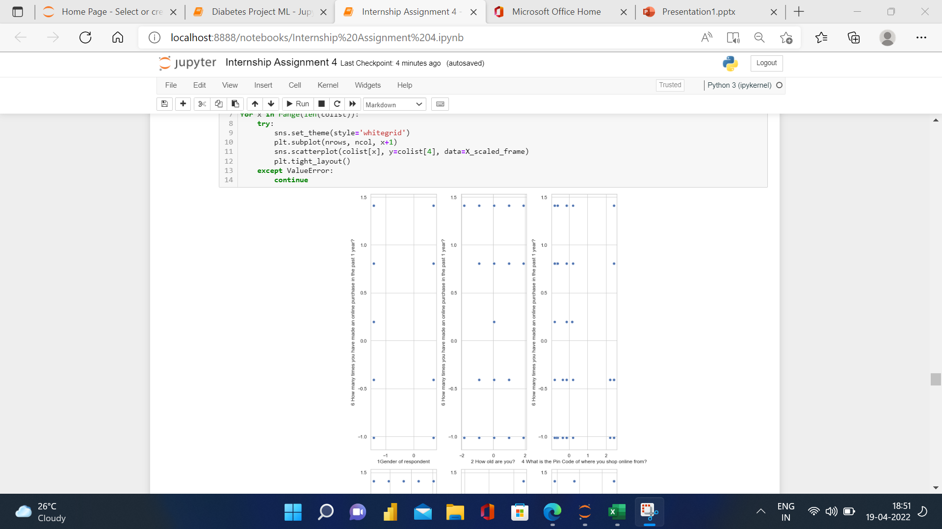
Scatter Plots
All the columns seem evenly spread from -2 to +2

Slide 19
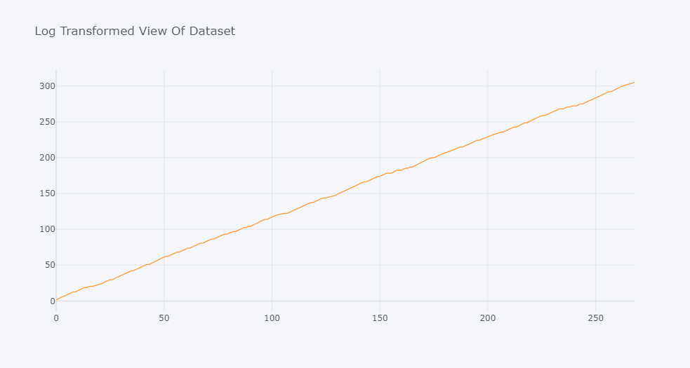

Slide 20

Log Transformation View Of Customer Loyalty
The graph starts from 1.61, indicating first respondent's response. After that, it saw a steady rise till ninth respondent, and fell slightly at the 10th respondent's response, indicating lesser loyalty from him. Then, it again picked up from 11th respondent and the line is crooked for all the respondents, indicating many less loyal customers. The last 9 customers seem to be quite loyal pulling the curve steadily upwards.

Slide 21

Outliers Detection
There seem very few outliers in the data. Major disintegration in views seem in the questions related with technical question about websites, example, question 46. Response for value for money is equally positive by all the respondents. As a conclusion, more customers can be attracted by offering more discounts because there are some outliers in monetary savings. Some additional things that can be done for customer loyalty is providing more product information and including more variety (because of some outliers are detected in these responses).
Please find graphs in jupyter notebook

Slide 22
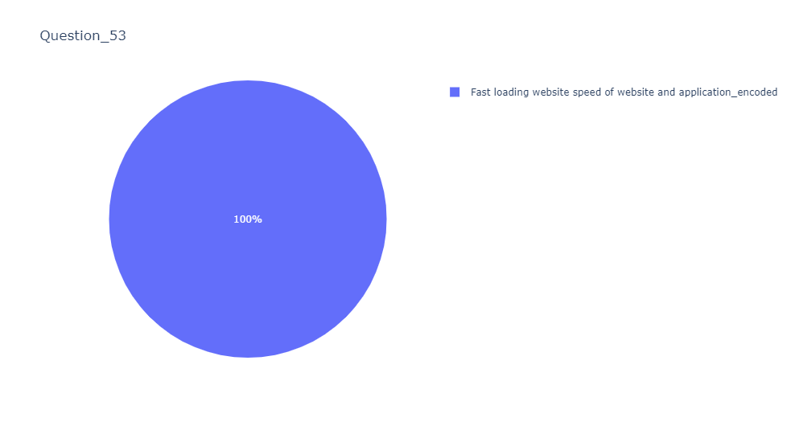
Group By View Of Data

Slide 23
Group By View Of Data
The above pie charts summarize responses of each question's responses as percentage of total responses for that question. Question and responses alongwith percentage coverage are pinned with each pie chart
Please find all the pie charts inn jupyter notebook

Slide 24
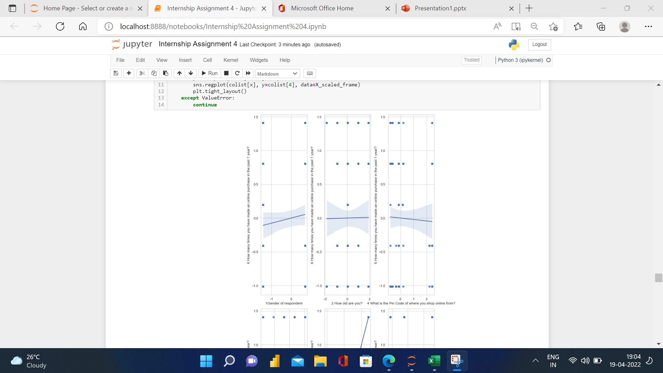
Regression Plots

Slide 25
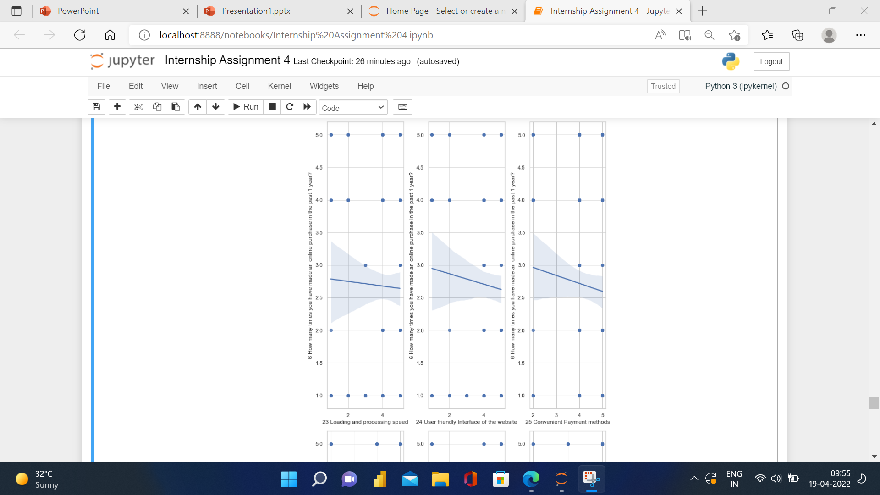
Practical Application (Contd...) Reg Plots

Slide 26
Regression Plots
There is seen rising correlation between loyalty and paired response for most of the questions. For example, gender, why did you abandon bag, shopping cart, responsiveness availability of several communication channel; etcetera. There seem falling correlation between loyalty and paired response for most of the questions. For example, loading and processing speed, user friendly interface of the website, convenient payment methods, etcetera. There seems no correlation between loyalty and paired response for most of the questions. For example, how old are you, the content on the website must be easy to read and understand.
Please find all the plots in jupyter notebook.

Slide 27
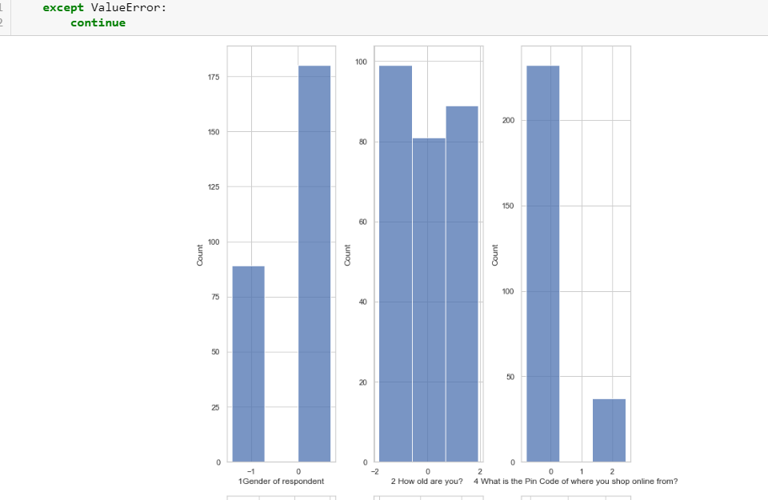
Histograms
Whole data seems standard normally spread in the range -2 to +2.
Please find all the histograms in jupyter notebook

Slide 28

Correlation
Tells if one variable changes how does it affect other variable. Interdependent variables are correlated.
Value close to +1 has large positive correlation
Value close to –1 has large negative correlation
Value close to 0 has no correlation

Slide 29
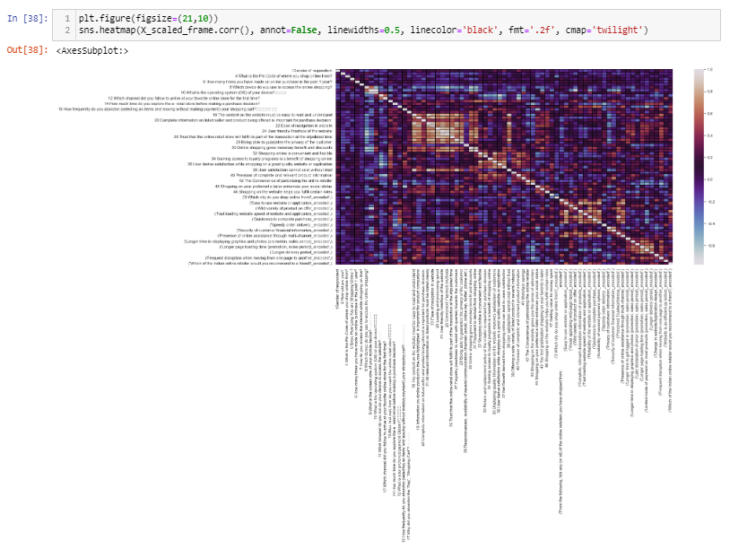
Correlation Analysis
Some of the multicollinearity pairs that can be spotted from this heatmap are q20 and q18; q22 and q23; q26 and q32, etcetera.

Slide 30

Descriptive Statistics
Gives a clear idea of distribution of the data.
Value count
Box plot
Scatter plot (says predictor can or not predict y).

Slide 31
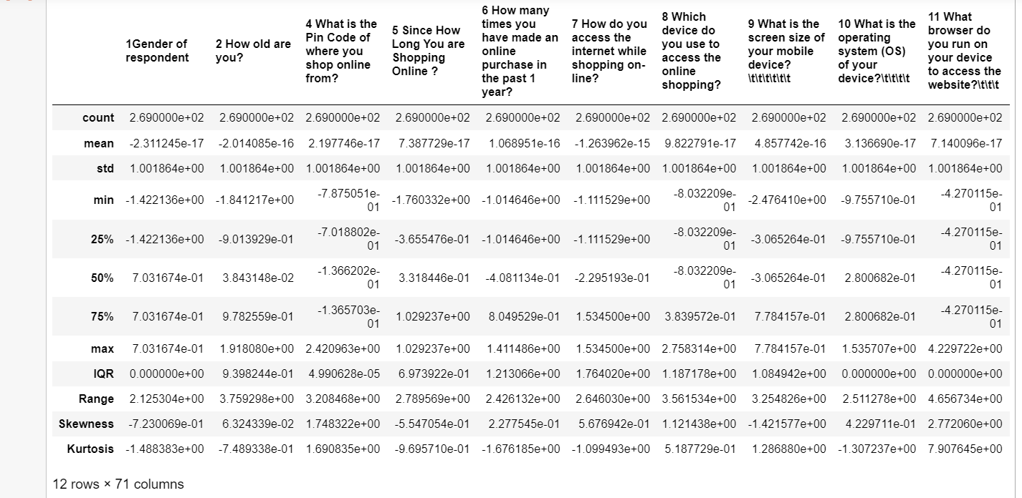
Practical Application (Descriptive Stats)

Slide 32
Descriptive Statistics Analysis
# Verbal Translation Of Descriptive Table And Graphic
## 1. Since, the data is standard normally scaled, mean is 0 and stdev is constant across all columns.
## 2. The entire dataset ranges from -2 to +2
## 3. IQR, Range and Skewness and kurtosis are a lot condensed.

Slide 33
## 4. Skewness is 0 and within +/- 0.65 for:
31 Enjoyment is derived from shopping online -0.565041473
35 Displaying quality Information on the website improves satisfaction of customers -0.555680997
5 Since How Long You are Shopping Online ? -0.554705402
39 Offering a wide variety of listed product in several category -0.551862601
46 Shopping on the website helps you fulfill certain roles -0.495053221
"16 How frequently do you abandon (selecting an items and leaving without making payment) your shopping cart? " -0.451429317
('Late declaration of price (promotion, sales period)_encoded',) -0.378928921
45 You feel gratification shopping on your favorite e-tailer -0.360912662
43 Shopping on the website gives you the sense of adventure -0.337315041
44 Shopping on your preferred e-tailer enhances your social status -0.248103429
47 Getting value for money spent -0.172500548
"13 After first visit, how do you reach the online retail store? " -0.155469993
('Longer delivery period_encoded',) -0.147702378
('Frequent disruption when moving from one page to another_encoded',) -0.10060793
('Limited mode of payment on most products (promotion, sales period)_encoded',) -0.086712355
2 How old are you? 0.063243385)
## 5. Acceptable skewness is +/- 0.65 and skewness for bell shaped curve should be 0.

Slide 34
## 6. Kutosis is upto 3 for most dataset, indicating platykurtic curves:
6 How many times you have made an online purchase in the past 1 year?,-1.6761847508356682
('Limited mode of payment on most products (promotion, sales period)_encoded',),-1.6461589136001202
"13 After first visit, how do you reach the online retail store? ,-1.6441167801553789"
('Longer time to get logged in (promotion, sales period)_encoded',),-1.6200532234069627
('Change in website/Application design_encoded',),-1.56852045375242
('Perceived Trustworthiness_encoded',),-1.4919829388876877
1Gender of respondent,-1.4883829318277395
Please find entire list in jupyter notebook

Slide 35
## 7. Kurtosis is greater than 3, indicating, leptokurtic curve:
12 Which channel did you follow to arrive at your favorite online store for the first time? ,3.2529314282739654
22 Ease of navigation in website,3.8443931551632926
33 Return and replacement policy of the e-tailer is important for purchase decision,4.222720000059679
27 Empathy (readiness to assist with queries) towards the customers,4.4693748482527
18 The content on the website must be easy to read and understand,4.6256745761081905
36 User derive satisfaction while shopping on a good quality website or application,5.033307415153846
29 Responsiveness, availability of several communication channels (email, online rep, twitter, phone etc.),5.114675110709765
"11 What browser do you run on your device to access the website? ,7.907645072451054"
## 8. Kurtosis for bell shaped curve should be 3

Slide 36
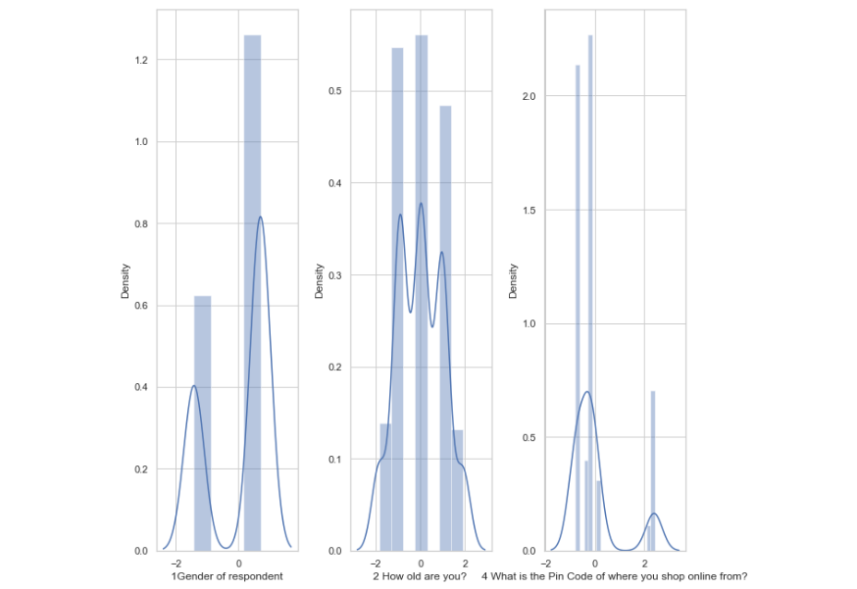
Distribution Plots

Slide 37
Distribution Plot Analysis
1. Skewness is 0 and within +/- 0.65 for:
31 Enjoyment is derived from shopping online -0.565041473 35 Displaying quality Information on the website improves satisfaction of customers -0.555680997 5 Since How Long You are Shopping Online ? -0.554705402 39 Offering a wide variety of listed product in several category -0.551862601 46 Shopping on the website helps you fulfill certain roles -0.495053221
Please find jupyter notebook for complete list

Slide 38
Contd...
3. Right skewness is observed in:
('Website is as efficient as before_encoded',),0.6620844676504234 ('Privacy of customersâ€™ information_encoded',),0.716860217635449 "17 Why did you abandon the â€œBagâ€, â€œShopping Cartâ€? ,0.7500365819834305" ('Availability of several payment options_encoded',),0.7816325195033343 ('Visual appealing web-page layout_encoded',),0.8130154727957809 ('Complete, relevant description information of products_encoded',),0.9640996524210493 ('Speedy order delivery _encoded',),1.0612425194318167
Please refer jupyter notebook for complete list.

Slide 39
Contd...
Left skewness is observed in:
27 Empathy (readiness to assist with queries) towards the customers,-2.294982203968875 33 Return and replacement policy of the e-tailer is important for purchase decision,-2.243625169670031 18 The content on the website must be easy to read and understand,-2.234126924867476 29 Responsiveness, availability of several communication channels (email, online rep, twitter, phone etc.),-2.1040158255285784 22 Ease of navigation in website,-2.0525598748458185
Please refer jupyter notebook for complete list.

Slide 40
Conclusion
How can Data Science help in customer retention?
Yes, data science can view this dataset as a classification problem to predict if the customer will stay with the current vendor. In case, historical data is not available unsupervised machine learning techniques can be applied and in case historical data of response vector is available, then, it can be processed further for VIF and ANOVA Analysis.
What kind of predictions can data scientists make with this data and can this explain if the customers will stay with the company for a long time? In other terms, what characteristics have more influence in prediction?
Yes, data science can view this dataset as a classification problem to predict if the customer will stay with the current vendor. In case, historical data is not availble unsupervised machine learning techniques can be applied and in case historical data of response vector is available, then, it can be processed further for VIF and ANOVA Analysis. Feature relevance is highlighted in Correlation Analysis, regression analysis and Descriptive Analysis. I have already highlighted all the features that are causing biasness in the data. Including response vector, one can find most correlated feature and that is the most important feature. Apart from this one can do, outliers transformation using power transform to completely remove outliers. VIF scores and ANOVA analysis can help in further multicollinearity reduction and feature selection in appropriate variance threshold, thereby, reducing bias and variance and developing a low risk model.

Slide 41
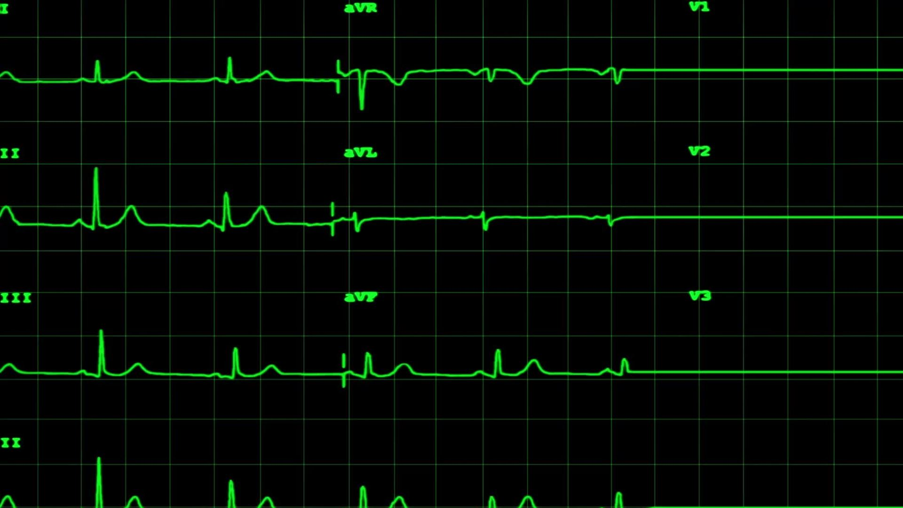
ANOVA
ANOVA stands for Analysis of variance.
It is used to find correlation between different groups of categoriical data.
We obtain:
F-Test Score: variation between sample group means divided by the variation within the sample mean.
P-Value: confidence degree.
F test should be greater than 1 and pvalue less than 0.05.

Slide 42

Thank You. Credits: Fliprobo, DataTrained and Python Documentation.

